Slide 1
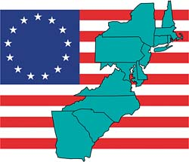
The 13 Colonies
A Brief Overview

Slide 2
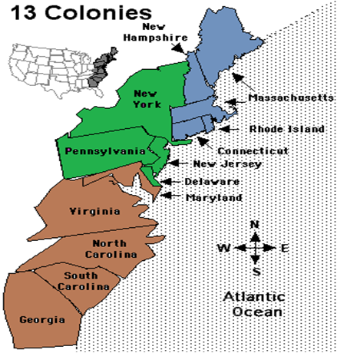
BLUE: New England Colonies (Massachusetts, Rhode Island, Connecticut, New Hampshire)
GREEN: Middle Colonies (New York, Pennsylvania, New Jersey, Delaware)
RED: Southern Colonies (Maryland, Virginia, North Carolina, South Carolina, Georgia)

Slide 3
Predict!
Look at the pictures with your group. Predict what it was like to live in the:
New England Colonies?
Middle Colonies?
Southern Colonies?

Slide 4
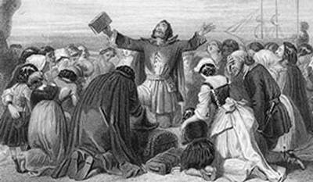
New England Colonies
Climate- Cold in the Winter
Positive: kept bugs away (less disease)
Negative: Harsh Weather killed many farmers
Geography:
Hills and rocky soil
Difficult for farming
Natural Resources: (more important than crops b/c crops were hard to grow)
Water- Drinking & Fishing
Forests- Wood
Economy
Timber was abundant– encouraged ship building
Ports- Important for trading. Colonies became very wealthy
Religion: Main function of New England was to support Puritan Religion – NO RELIGIOUS FREEDOM!

Slide 5
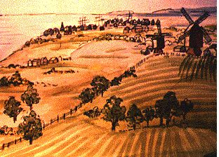
Middle Colonies
Climate:
Relatively hot– allowed for a longer growing season
Cooler than Southern colonies – less disease
Geography:
Soil was less rocky than New England & Fertile
Economy: Considered the “commercial hub” of the Eastern Colonies
“Bread Basket”: Because of large grain export
Culture & Religion:
Culturally & Ethnically diverse
Colonists from many European countries
Many different religions

Slide 6
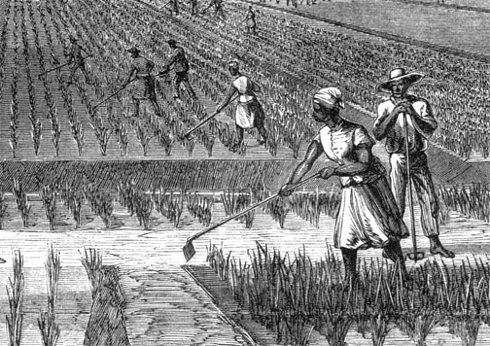
Southern Colonies
Climate: Warmest of the 3 Colonial Regions
Positive: didn’t worry about cold, longer farming season
Negative: diseases
Geography:
Broad coastal plain, hilly, forests
Natural Resources:
Rich farmland, forests, and fish
Economy:
Farming was VERY IMPORTANT!!!!
Driven by Plantations
Originally Indentured Servants worked → Replaced by slaves
Tobacco, Cotton, Indigo, Rice

